Slide 1

Communication systems project review
Submitted by: Harshal chowdhary (2k19/ec/071)
Ishita agrawal (2k19/ec/077)

Slide 2

Project review
Project Title – analysis of different modulations on gui
Category of project – simulation based
by – harshal chowdhary ishita agrawal
2k19/ec/071 2k19/ec/077
Harshalchowdhary_2k19ec071@dtu.ac.in Ishitaagrawal_2k19ec077@dtu.ac.in

Slide 3

Survey and motivation for the project
Survey – MATLAB is a software with many features. One of those is a MATLAB APP DESIGNER. We surfed internet to get sources to learn APP designing on MATLAB.
Motivation - Pictorial Representations are used for better understanding of concepts and it makes teaching more better.
APP DESIGNER will help to show these representations in a user-friendly way and makes it interesting.

Slide 4
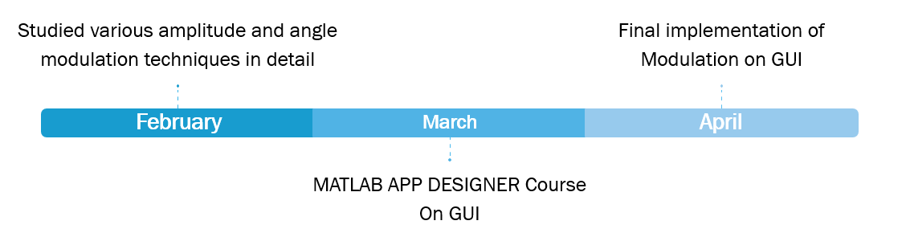
timeline
objectives
Better understanding of above mentioned concepts by students.
Through the implementation on GUI, it will be beneficial for further teaching purposes.
Strengthen the concepts, for upcoming semesters.

Slide 5
How it is related to field of communication systems
The communication system which describes the information exchange between two points. The process of transmission and reception of information is called communication. The major elements of communication are the Transmitter of information, Channel or medium of communication and the Receiver of information.
Modulation is an essential part of communication system. The purpose of modulation is to impress the information on the carrier wave, which is used to carry the information to another location without the loss of any kind of information.

Slide 6
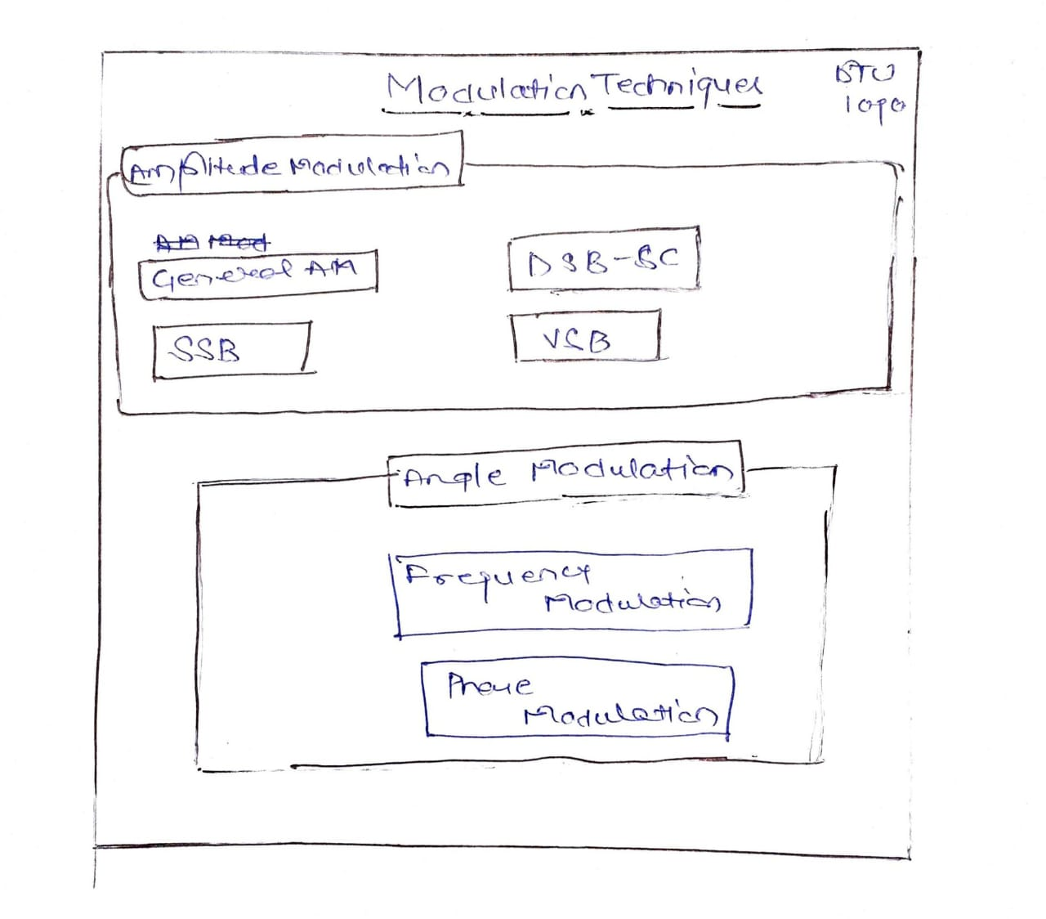
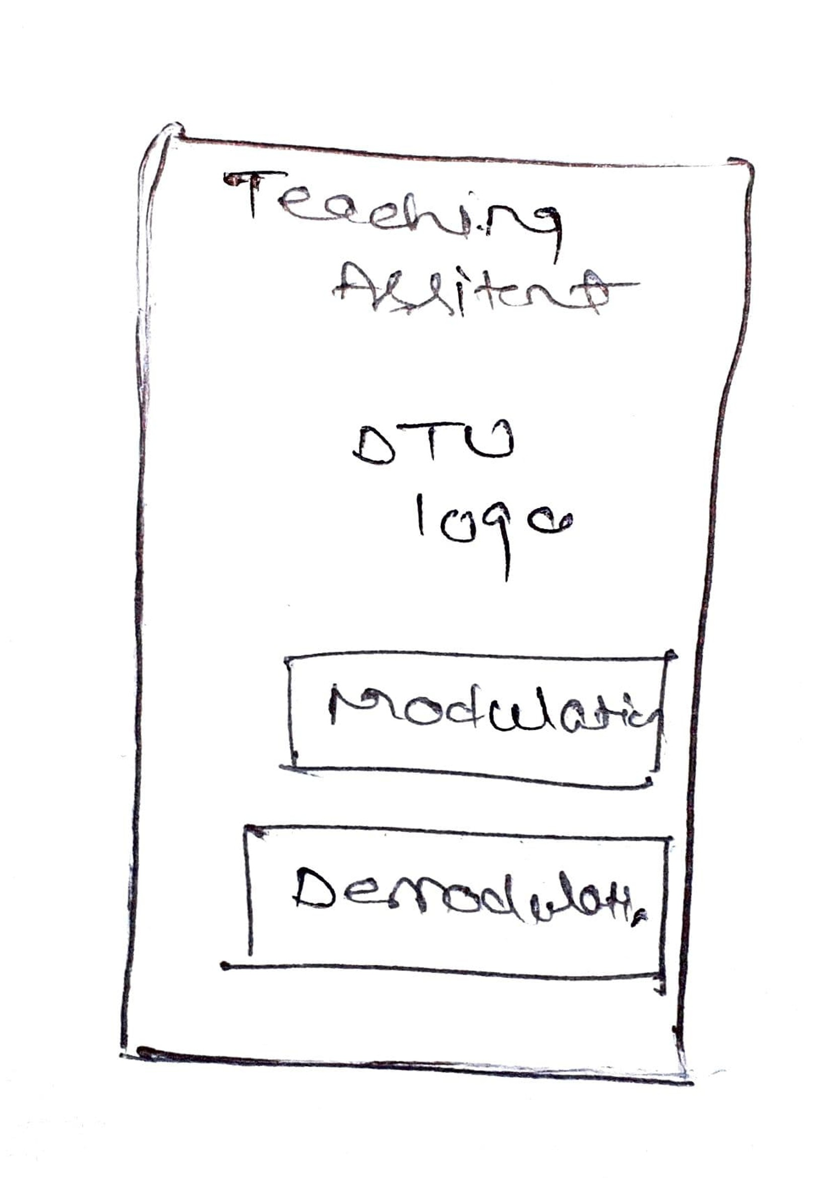
Proposed G.u.i

Slide 7
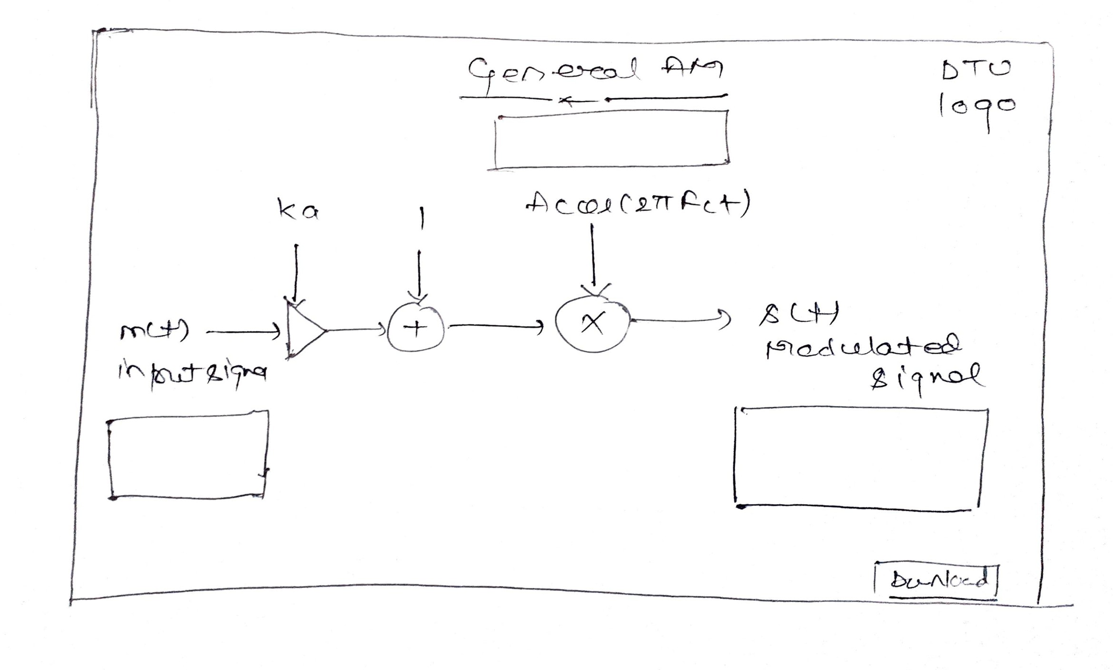
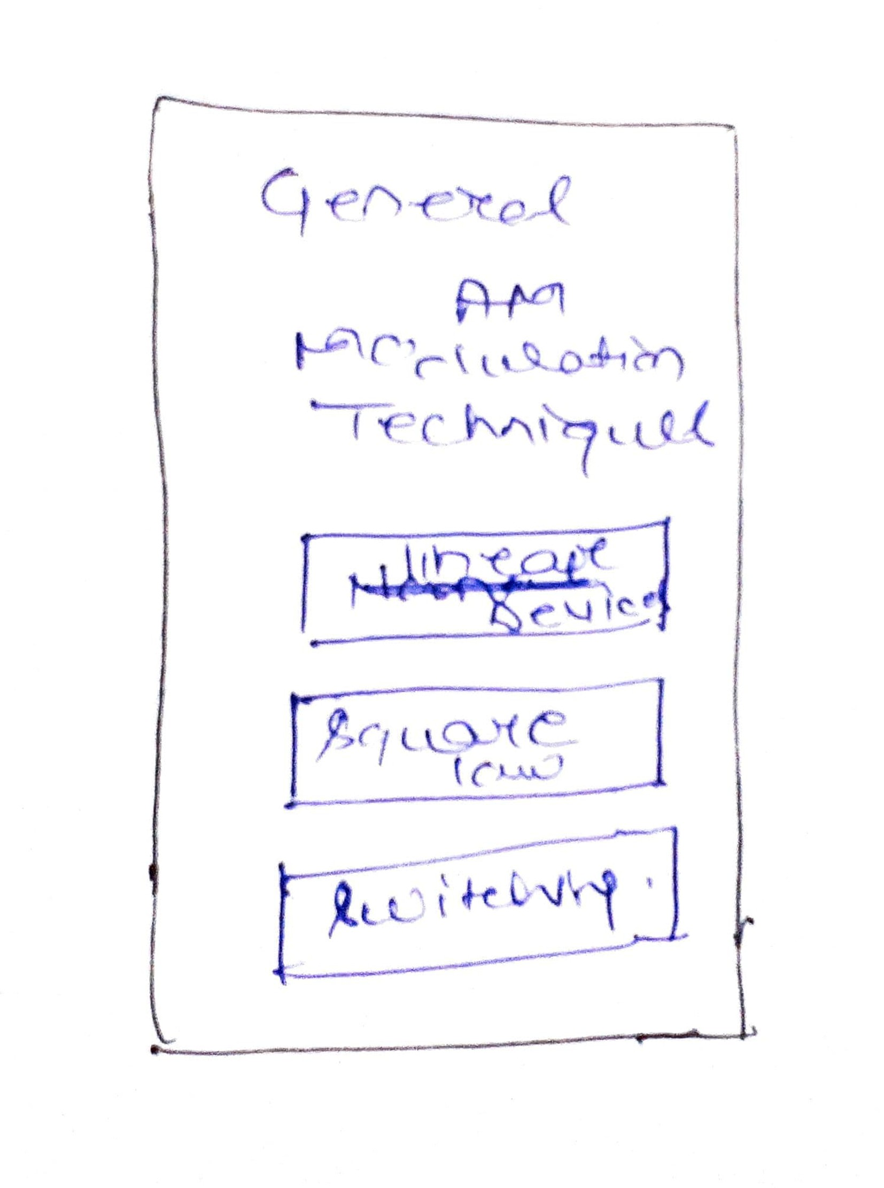
Proposed G.u.i.

Slide 8
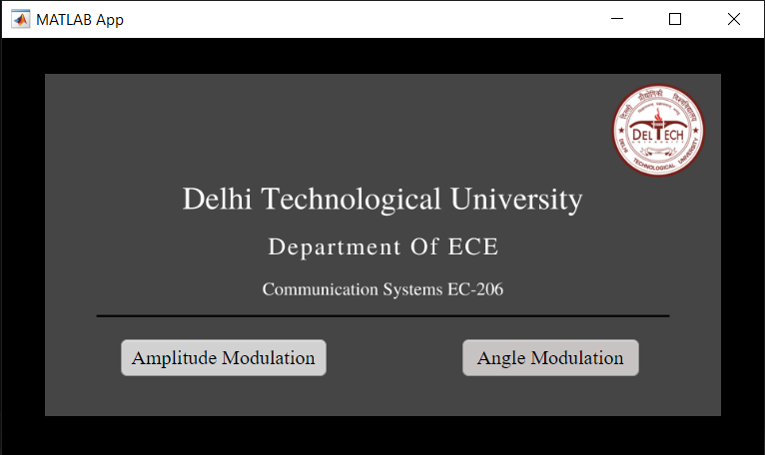
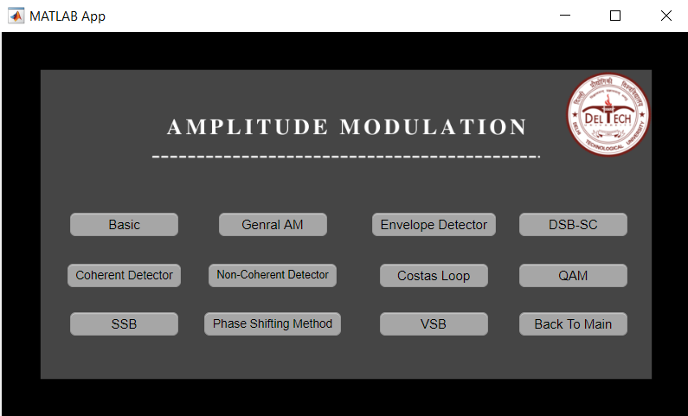
Final g.u.i.

Slide 9
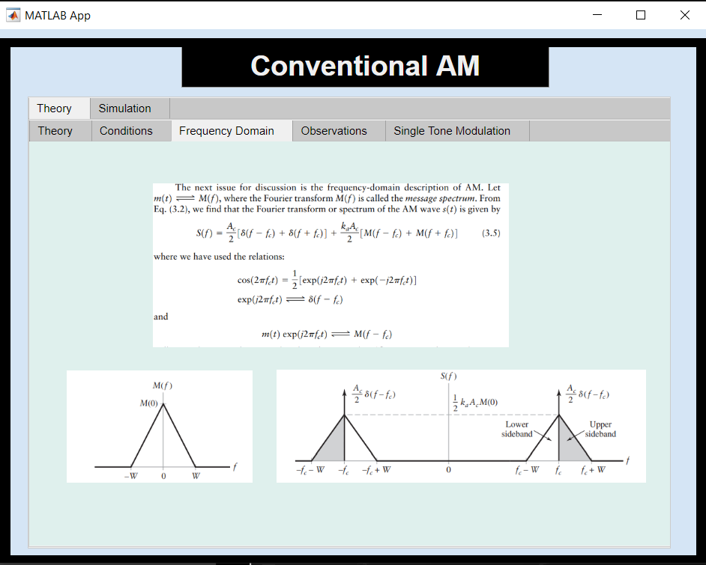
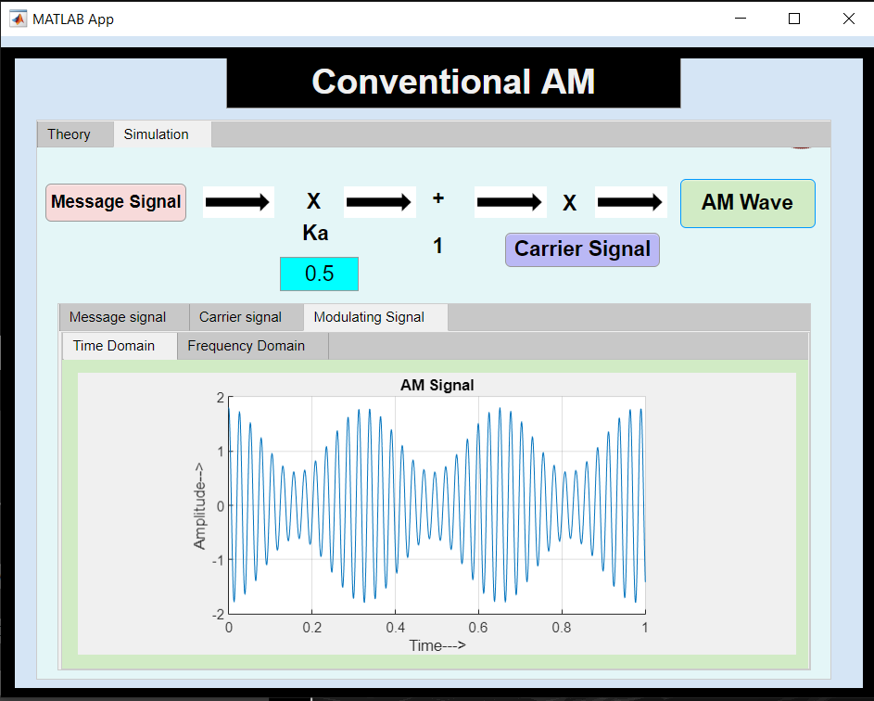
Final g.u.i.

Slide 10
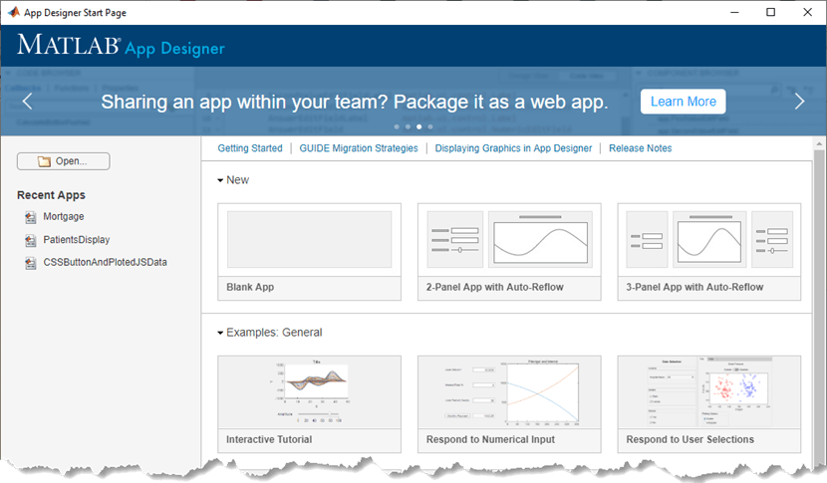
Problem faced
CRASHING OF MATLAB APP DESIGNER

Slide 11
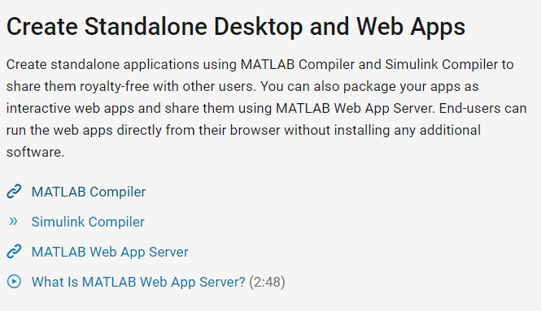
Solution of Those problems
MATLAB Compiler & Web Apps
Alternative Approach
Tkinter –
The tkinter package (“Tk interface”) is the standard Python interface to the Tk GUI toolkit. Both Tk and tkinter are available on most Unix platforms, as well as on Windows systems. (Tk itself is not part of Python; it is maintained at Active State.)
Running python -m tkinter from the command line should open a window demonstrating a simple Tk interface, letting you know that tkinter is properly installed on your system, and also showing what version of Tcl/Tk is installed, so you can read the Tcl/Tk documentation specific to that version.

Slide 12
Future scope
Looking forward to implement further topics of Analog Communication Curriculum.
Using MATLAB web app. We can publish this as a website where students can use this app for better understanding.
This interface can be used as Virtual Lab by developing another tab for experiments.

Slide 13
List of references
Communication Sysytem by Simon haykin
https://www.wiley.com/en-us/Communication+Systems,+5th+Edition-p-9780471697909
Digital Communication By John G. Proakis https://arnabiitk.files.wordpress.com/2013/02/proakis-digital-communications-4th-ed.pdf
Principle Of Communication By Prof. Aditya k. Jagannatham https://youtube.com/playlist?list=PLyaVharzrSGwU487lNxjWPJK3qS48Dydg
Youtube Playlist of Vaishali e'learning
https://youtube.com/playlist?list=PLXnsjPD8-xuvuHKopadw0omnXZXKFTXkx

Slide 14
THANk you ☺

